Slide 1
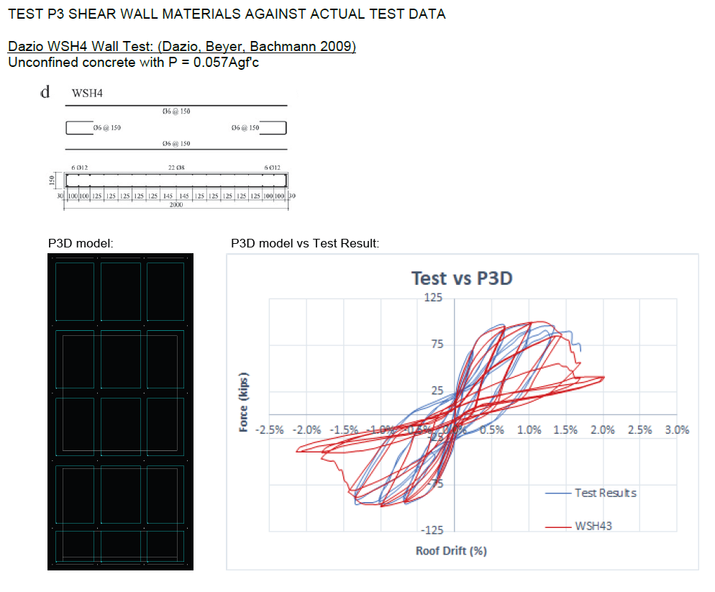
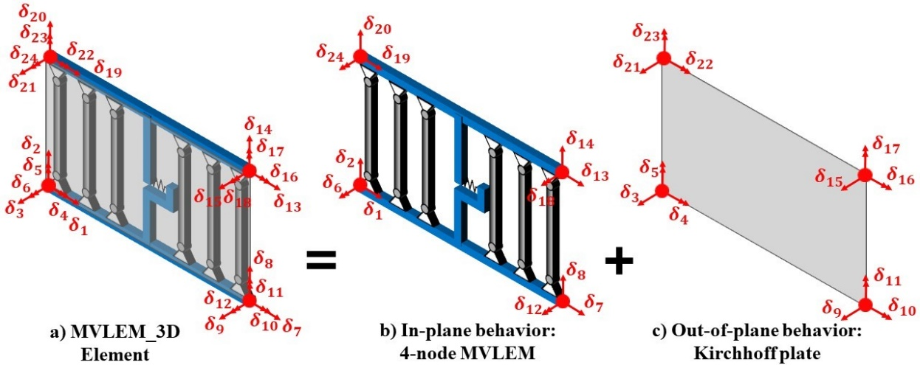
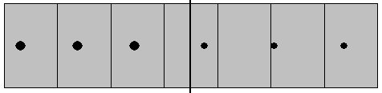

MVLEM 3D - calibration
Cross section definition

Slide 2
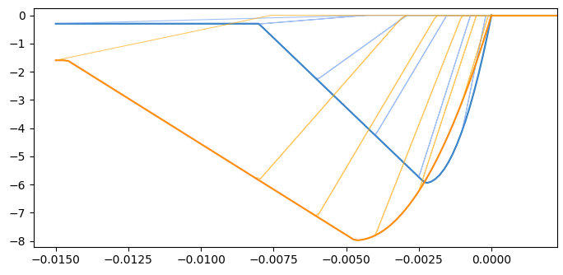


MVLEM 3D – concrete MATERIAL
Concrete01
unconfined
Stress [ksi]
confined
Strain [-]
Cross section definition
Incorrect initial slope due to parabolic shape

Slide 3
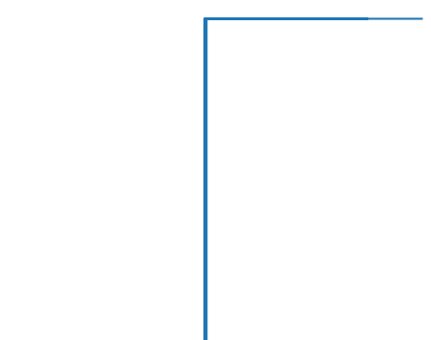
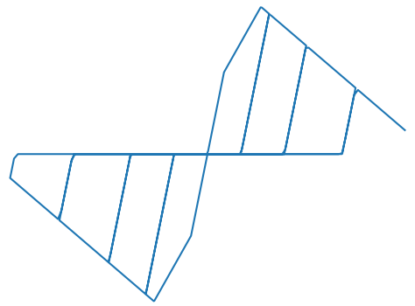
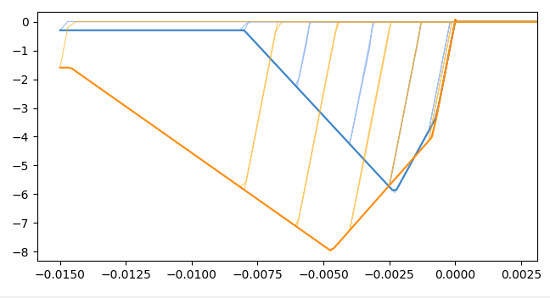
MVLEM 3D – CONCRETE MATERIAL
ENT
Hysteretic
Series Material
unconfined
Stress [ksi]
Cross section definition
confined
Strain [-]

Slide 4

MVLEM 3D – REBAR MATERIAL
Hysteretic Material
(need non-symmetric tensile and compressive behavior)
unconfined
Cross section definition
Stress [ksi]
$$ε_{R}$$
confined
Strain [-]

Slide 5
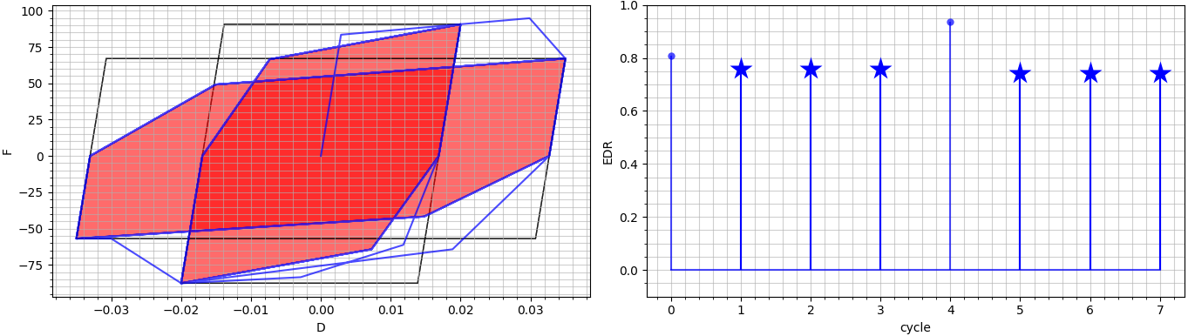
MVLEM 3D – REBAR MATERIAL
When strain is first increased to a higher level, a jump occurs. Subsequently, the EDR stabilizes at the target value during further cycles at the same strain level.
pinch_x = 0.25, pinch_y = 0.75
Energy dissipation factor = 0.75 (Lowes and Baker 2018)

Slide 6
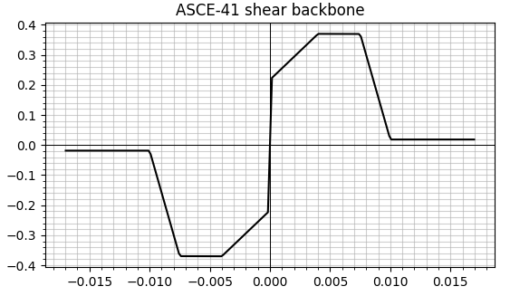
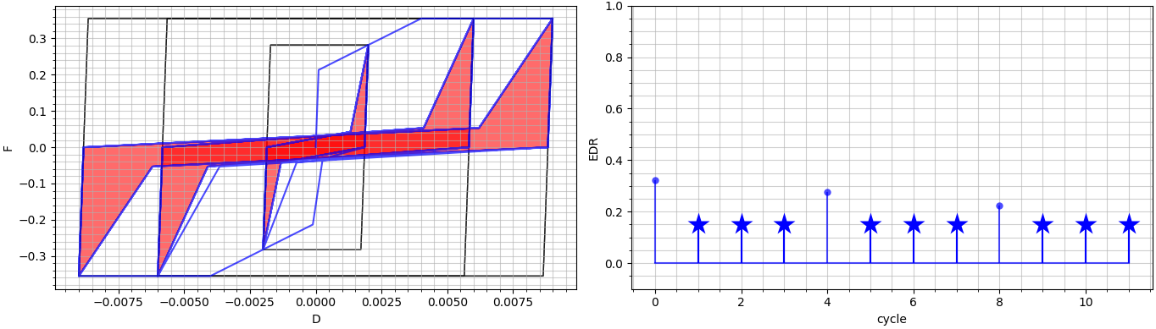
MVLEM 3D – SHEAR MATERIAL
stress
HystereticSM Material (allows modeling 4-point envelope)
strain
pinch_x = 0.75, pinch_y = 0.15
Target EDR = 0.15

Slide 7
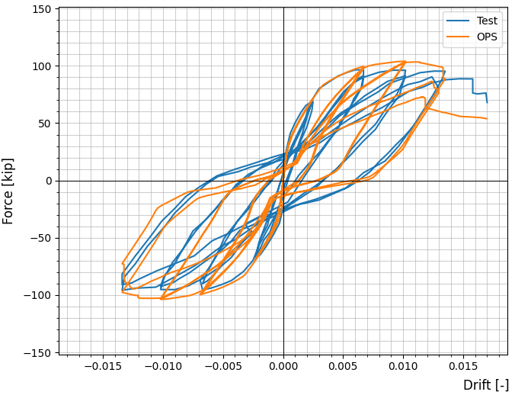
MVLEM 3D – comparison with experimental results

Slide 8
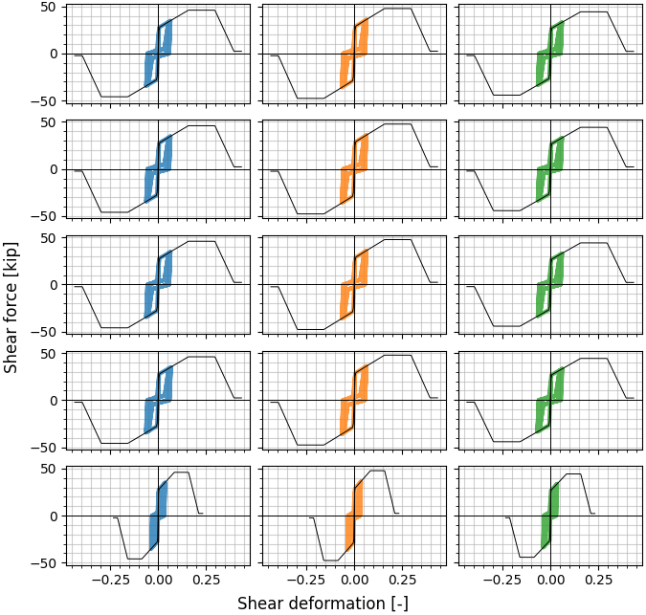
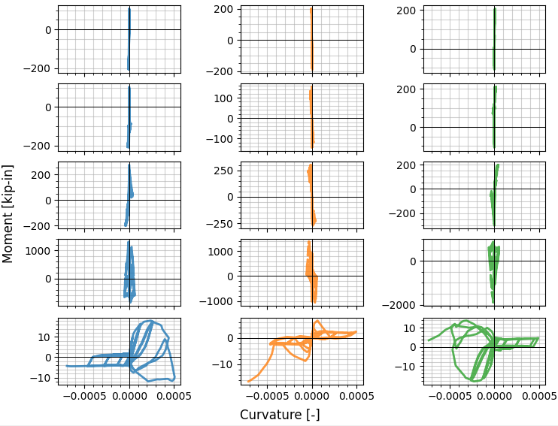
MVLEM 3D – ELEMENT RESPONSE

